Slide 1
What is Spice?
Spice is the short form of:
Simulated
Program with
Integrated
Circuit
Emphasis

Slide 2
PSPICE Programming
Why PSPICE Programming
Steps of Programming
Statements
Data Statements
Control Statements
Example Circuits

Slide 3
Why PSPICE Programming
Don’t have to draw the circuit
More control over the parts
More control over the analysis
Don’t have to search for parts
Some SPICE softwares (HSPICE etc.) don’t have GUI at all
Quick and efficient

Slide 4
Steps of Programming
Draw the circuit and label the nodes
Create netlist (*.cir) file
Add in control statements
Add in title, comment & end statements
Run PSPICE
Evaluate the results of the output

Slide 5
Statements
Different statements:
Not case sensitive
Title: first line of code (always)
.END <CR>: last line of code (always)
Comment: line denoted by *
Comment within a statement is preceded by a semicolon (;)
+ means continuation of a sentence
Data: resistor, capacitor, etc.
Control: analysis and output

Slide 6
Data Statements
Resistor
R<name> <node1> <node2> <value>
Example: R1 1 2 100
Capacitor
C<name> <node1> <node2> <value>
Example: Cs 13 0 1u
Inductor
L<name> <node1> <node2> <value>
Example: LR 5 4 1m

Slide 7
Data Statements
Independent Voltage Source
V<name> <+ node> <- node> [[DC] <value>] [AC <magnitude> [phase]] [transient + specification]
3 types of sources:
DC: Vin 1 0 5
AC: Va 4 0 AC 25
Transient

Slide 8
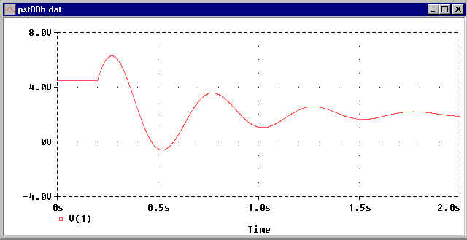
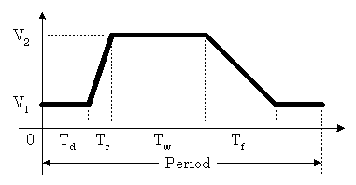
Data Statements
Transient Source
Vname <n+> <n-> SIN(Vo Va freq td phase)
Vname <n+> <n-> PULSE(V1 V2 Td Tr Tf Pw Period)
Vname <n+> <n-> PWL(t1,v1,t2,v2,…,tn,vn)

Slide 9
Data Statements
Independent Current Source
I<name> <+ node> <- node> [ [DC] <value> ] [AC <magnitude> [phase]] [transient + specification]
Same as Independent Voltage Source

Slide 10
Data Statements
MOSFET
M<name> <drain node> <gate node> <source node> <substrate node> <model name> [L=<value>] [W = <value>]
.MODEL <model name> <NMOS or PMOS> [model parameters]
Example:
M1 1 2 3 3 NTYPE W=10U L=50U
.MODEL NTYPE NMOS (VTO=-3 KP=1E-5)

Slide 11
Data Statements
MOSFET Parameters
Parameter | Description | Default value
VTO | Threshold voltage | 0
KP | Conductance parameter | 0.02 mA/V²
CBD | Drain-to-substrate capacitance | 0
CBS | Source-to-substrate capacitance | 0
TOX | Oxide-layer thickness | 10⁻⁷ m

Slide 12
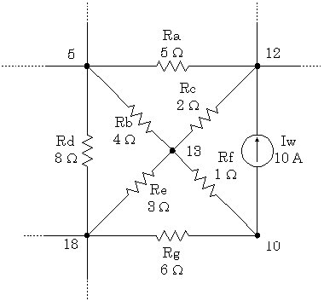
Data Statements
Sub Circuit
.SUBCKT Example_1 5 12 18 Iw 10 12 10A Ra 5 12 5.0 Rb 5 13 4.0 Rc 12 13 2.0 Rd 5 18 8.0 Re 13 18 3.0 Rf 10 13 1.0 Rg 10 18 6.0 .ENDS

Slide 13
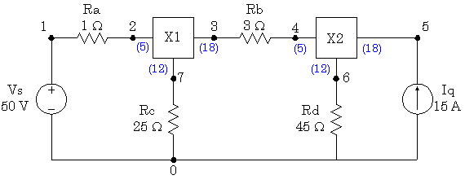
Data Statements
.INLUDE Exampl_1.CIR
Vs 1 0 50
Iq 5 0 15
Ra 1 2 1
Rb 3 4 3
Rc 7 0 25
Rd 6 0 45
X1 2 7 3 Example_1
X2 4 6 5 Example_1
.END

Slide 14
Data Statements
Suffixes
f | femto | 10⁻¹⁵
p | pico | 10⁻¹²
n | nano | 10⁻⁹
u | micro | 10⁻⁶
m | milli | 10⁻³
k | kilo | 10³
meg | mega | 10⁶
g | giga | 10⁹
t | tera | 10¹²

Slide 15
Control Statements
Analysis Types
DC Analysis: .DC
AC Analysis: .AC
Transient Analysis: .TRAN
Output Format
Text Output: .PRINT, .PLOT
Graph Output: .PROBE

Slide 16
DC Analysis
Format
.DC <source> <vstart> <vstop> <vincr> [src2 start2 stop2 incr2]
Example:
.DC Vin 0.25 5.0 0.25
.DC Vds 0 10 0.5 Vgs 0 5 1

Slide 17
DC Analysis
PLOT I-V Characteristics of NMOS
VTO = +1V
KP = 30u
MOSFET I-V Characteristics
M1 1 2 0 0 NTYPE
.MODEL NTYPE NMOS(VTO=1 KP=30u)
Vgs 2 0 5
Vds 1 0 5
.PROBE
.PRINT DC I(Vds)
.DC Vds 0 5 .5 Vgs 0 5 1
.END
D
G
I_{D}
S

Slide 18
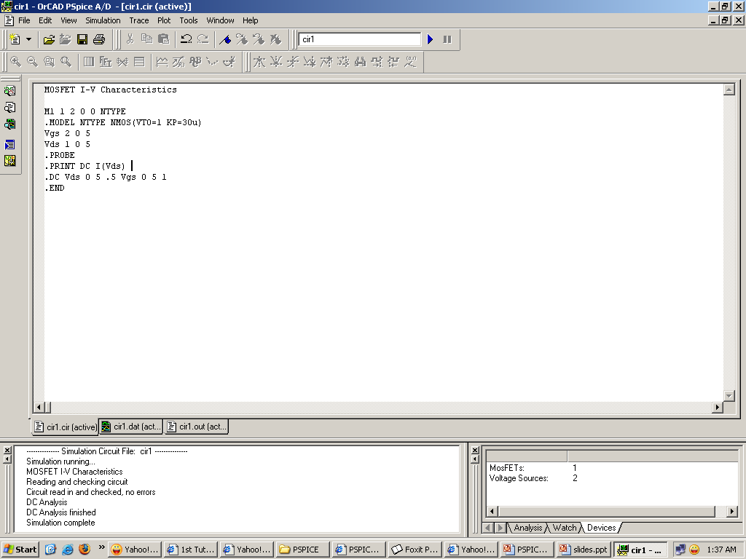

Slide 19
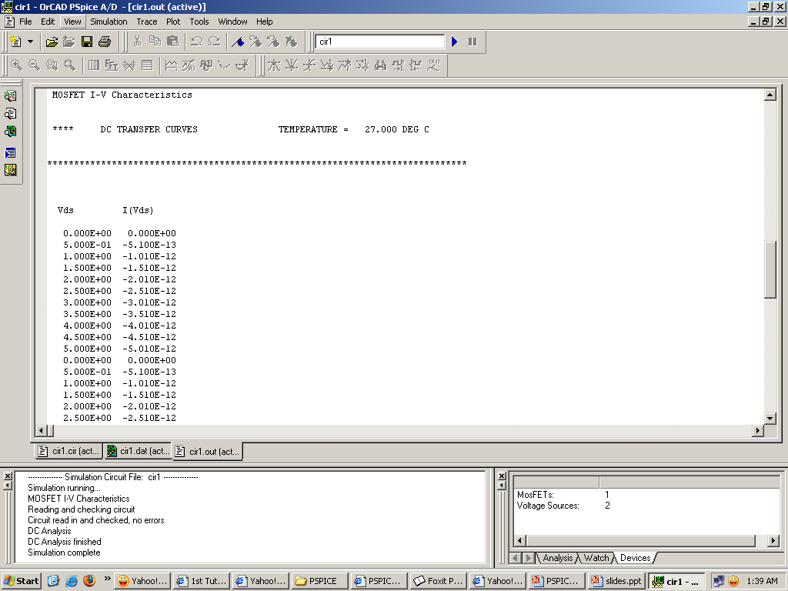

Slide 20
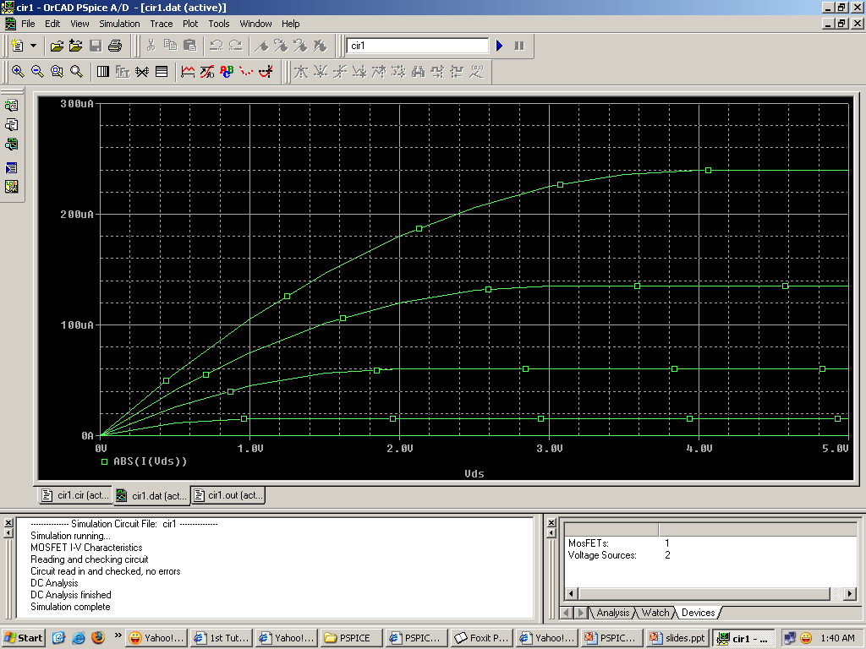

Slide 21
AC Analysis
Format
.AC <sweep type> <points value> <start frequency> <end frequency>
<sweep type> is either LIN, OCT, or DEC
Example
.AC LIN 1 60Hz 600Hz
.AC LIN 11 100 200
.AC DEC 20 1Hz 10kHz

Slide 22
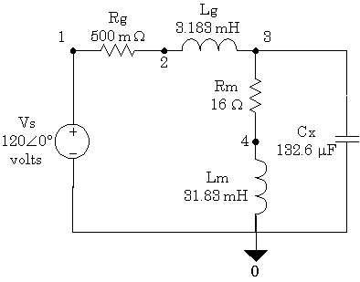
AC Analysis
60 Hz AC Circuit
Vs 1 0 AC 120V 0
Rg 1 2 0.5
Lg 2 3 3.183mH
Rm 3 4 16.0
Lm 4 0 31.83mH
Cx 3 0 132.8uF
.AC LIN 1 60 60
.PRINT AC VM(3) VP(3) IM(Rm) IP(Rm) IM(Cx) IP(Cx)
.END

Slide 23
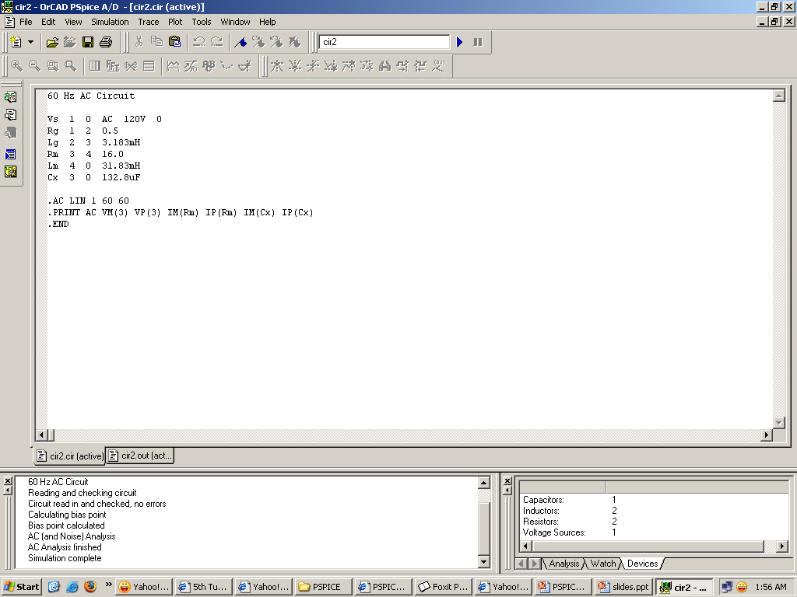

Slide 24
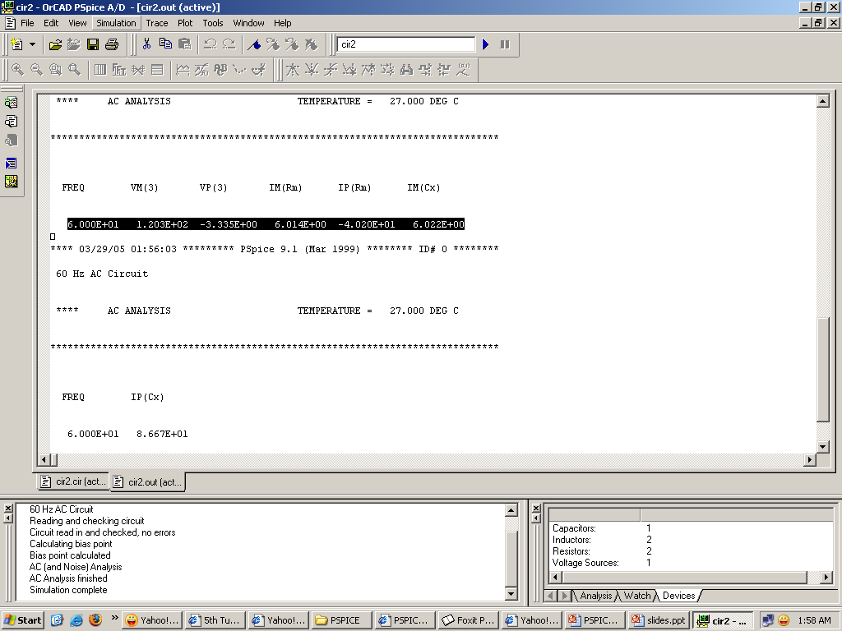

Slide 25
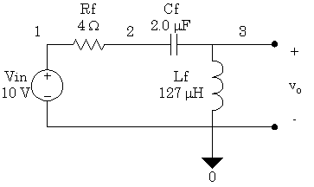
AC Analysis
Second-Order High-Pass Filter
Vin 1 0 AC 10V
Rf 1 2 4.0
Cf 2 3 2.0uF
Lf 3 0 127uH
.AC DEC 20 100Hz 1MEG
.PROBE
.END

Slide 26
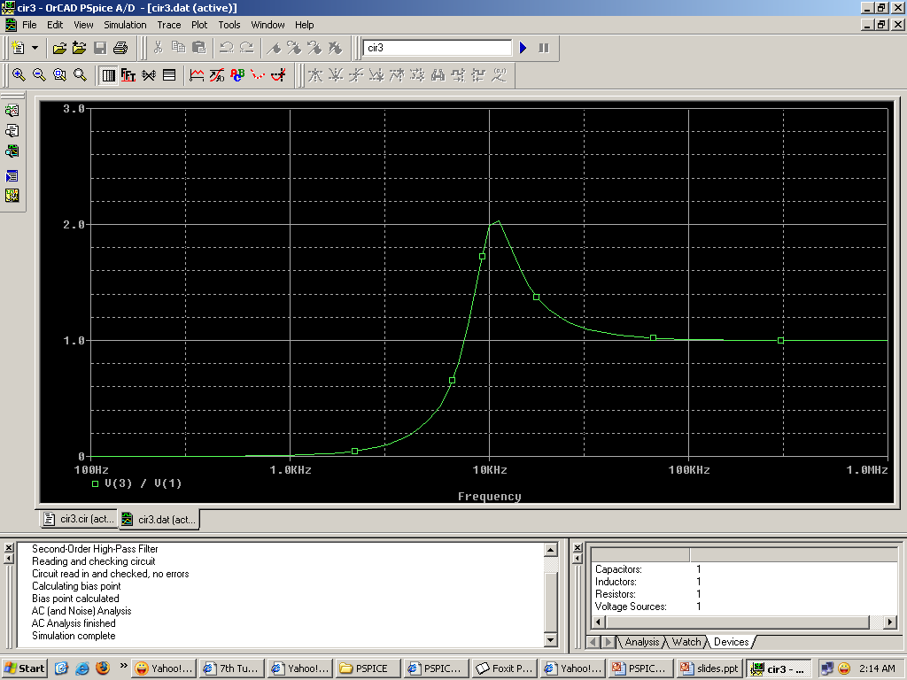

Slide 27
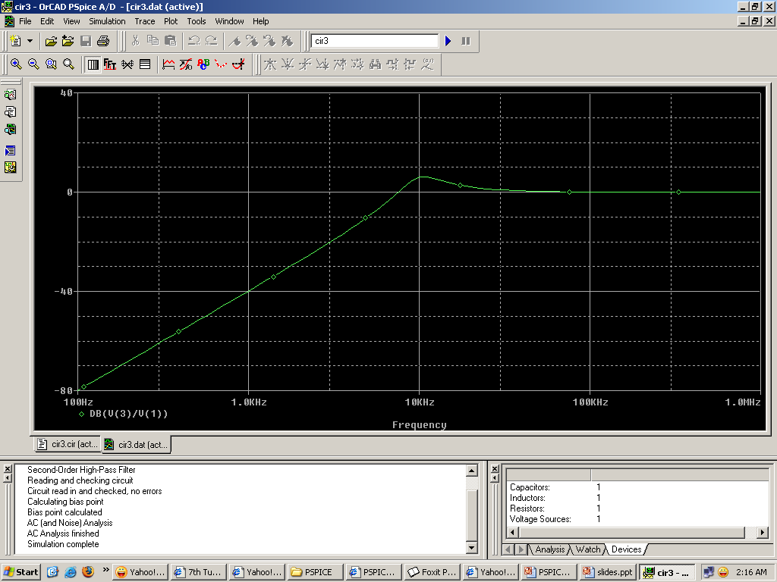

Slide 28
Transient Analysis
Format
.TRAN <print step> <final time> [no-print value]
Example
.TRAN 1n 1000n
.TRAN 1n 1000n 500n

Slide 29
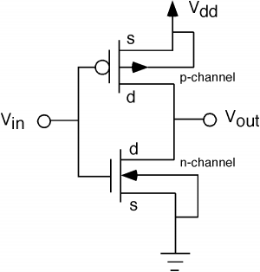
Transient Analysis
CMOS Inverter
Vin 1 0 pulse(0 5 0 1p 1p 5n 10n)
Vdd 3 0 5
M2 2 1 3 3 PTYPE W=5u L=2.5u
M1 2 1 0 0 NTYPE W=5u L=5u
.MODEL PTYPE PMOS(KP=15u VTO=-1)
.MODEL NTYPE NMOS(KP=30u VTO=1)
.PROBE
.TRAN 1n 20n
.END
3
1
2
0

Slide 30
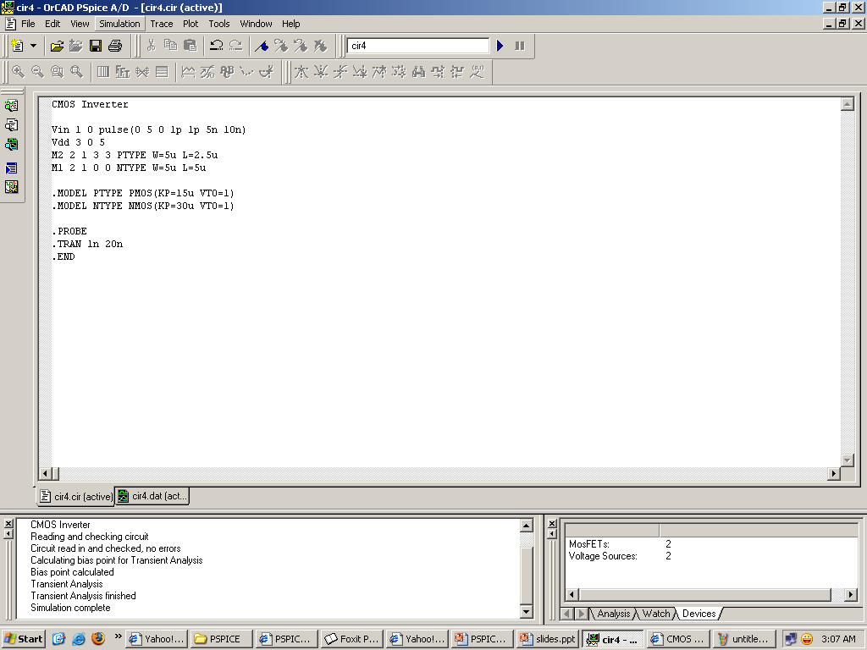

Slide 31
